Slide 1
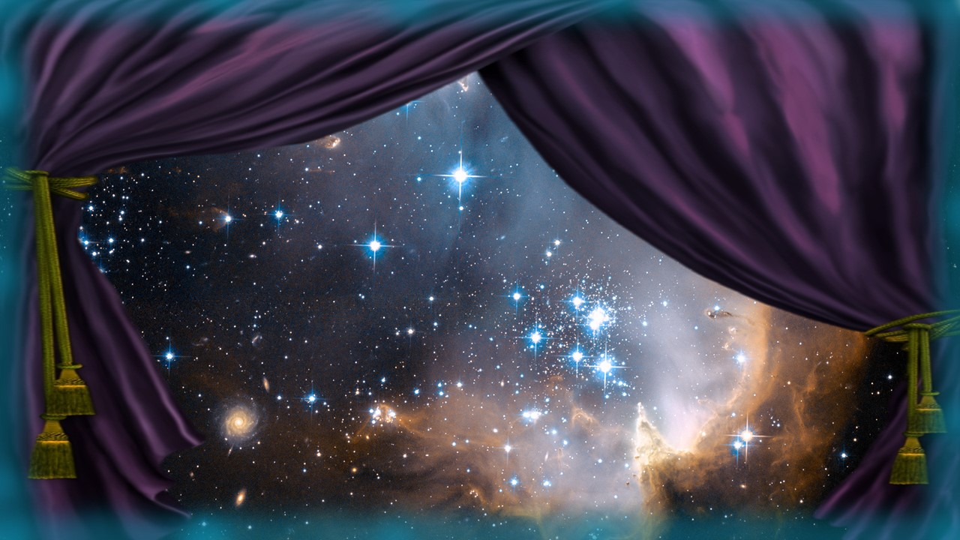

Shemar the Shemesh Scurry!
Eccl 1:5
Part 1

Slide 2
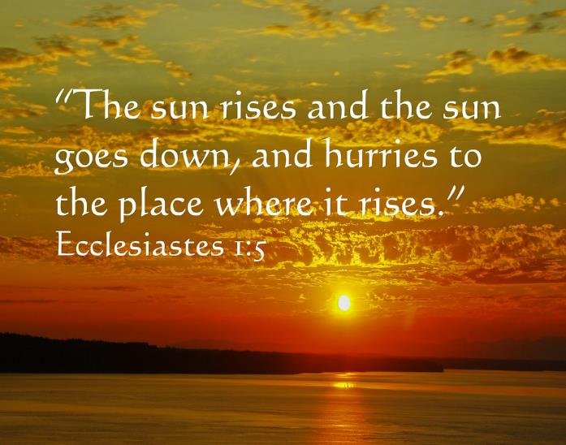
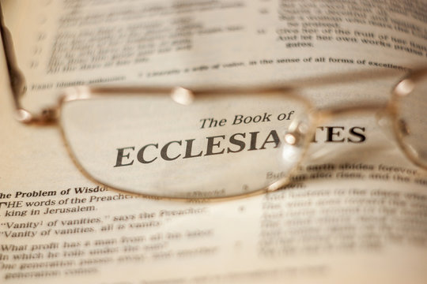
Solomon Declared
Shemesh was in a Scurry!
Ecc 1:5 The sun also ariseth, and the sun goeth down,
and hasteth to his place where he arose. ^{KJV}

Slide 3

Have you ever questioned why it is the sun is in a HURRY?
Ecc 1:5
And if so, are you listening? Shema?

Slide 4
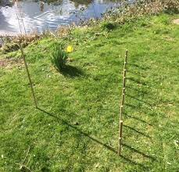
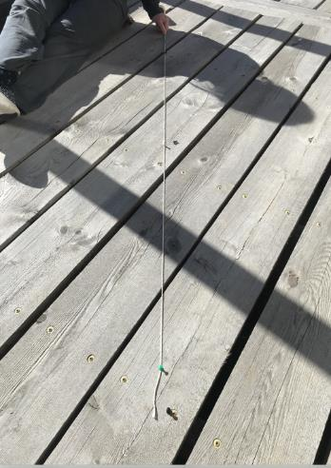
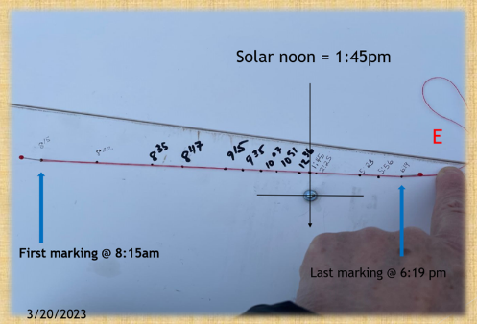
Shemar the Shemesh Scurry! ☺
Have you marked your straight shadow yet?
… Nor Shadow
of Turning!
Ya’aqov 1:17
James
03/19/2023

Slide 5

As we begin - please note:
This study
may be at an intermediate level for many.
Glean as much as you can!
It will be worth it!

Slide 6
Creation’s Cycle # 4
Gen 1:14
“Let LIGHTS come to be, … and let them be for SIGNS …”
Will this command reveal the reason Abraham sacrificed a calf (Gen 18:7) and was recorded as
SITTING DOWN?
^{Let’s start}
^{at the}
^{beginning~}
Could a SHADOW be a LIGHT SIGN?

Slide 7

What is the Kingpin Catalyst
SIGN established by Yahuah?
And, could it be important to
MARK?
A broad HINT is found on slide #8!

Slide 8
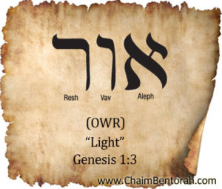
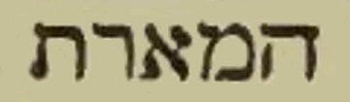
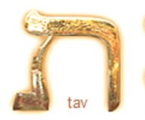
e-marth - luminaries
Why is it that this word is found only 3 times with a Tav at the end?
Gen 1:14, 15 & 16! ??????
Is there an EVENT connection?
Remember that a Tav, can be a Sign, a Seal,
a Mark, a Signature and a COVENANT!

Slide 9

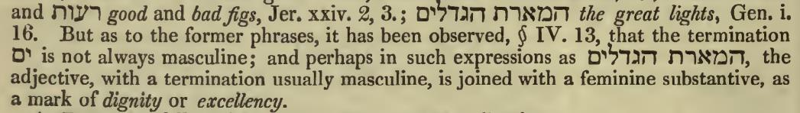
A Hebrew Lexicon by J Parkhurst (1762) Pg. 42
The Grammar Section: comment on the great lights.
emarth egdolim
the great lights
Note the Tav!
Maybe, AN ETERNAL COVENANT?

Slide 10

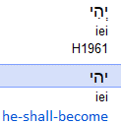

e-maurt - aur, the root, is light!
NOTE: was NOT CREATED HERE!
There was no need to re-create that which was already CREATED ON CYCLE #1. See Gen 1:1!
Gen 1:14
Could this then be an “assignment of duty”?
MAYBE - AN ETERNAL MANDATE APPLICATION! ?
And Elohim said, “Let lights come to be in the expanse of the shemayim …”
Considering this as a GREAT COMMISSIONING,
WHAT IDENTITIES were ASSIGNED A DUTY?
Also; what was & what is, that duty - TODAY?

Slide 11



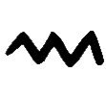

And Elohim said, “Let lights come to be …”
Please note the BLUE UNDERLINED LETTERS!
The Hebrew letters starting at the Aleph - the pillar of strength in The Kingdom.
Resh – the Head (center of authority), – (is forming a)
Tav – Covenant, Mark, Sign,
Seal and Signature.
What might this Covenanted Signature Seed encapsulate?
Before going further, we need to search carefully for the meaning of a
Mem.
The base meaning of this letter cannot be overstated at this point.
א
ר
מ
ת
Eternity?

Slide 12
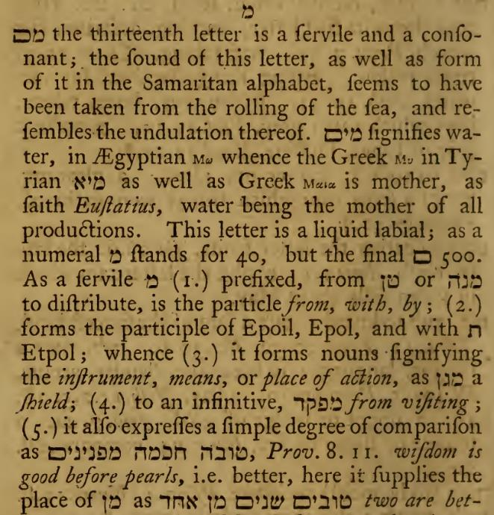

Mem
מ
Quote from; A Hebrew Lexicon by W.H. Barker 1776 Pg. 114
Undulations - directly equates to FREQUENCIES!
The Mem indicates a limitless DISTRIBUTION PROPERTY
containing FREQUENCIES.
Gen 1:14 SPEAKS INTO -
Yahuah, establishing His
COVENANTED SYSTEM. A FREQUENCY SIGNATURE for LIFE encapsulated within LIGHT!
THIS IS NOT JUST PHYSICAL LIGHT!

Slide 13
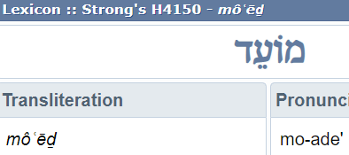
What of – FREQUENCIES?
ד
ע
וֹ
מ
Is there a possibility of the MEM FREQUENCY being built within the Qodesh Convocations that return each and every year in exact SHANEH timing?
Mo-ed
Look for it!
Tequfot, 7th day Shabbat, Passover, Unleavened Bread, Wave Sheaf, Pentecost, Trumpets, Tabernacles, Jubilees;
are these Qodesh Identities - returning in a cyclical fashion?
Is there a certain – Frequency - to these Mo-edim (Feasts)
returning Shaneh (year), after Shaneh (year)?
Equinox
TESHUVA!

Slide 14
What of – Tequfah? (circuit)
The Tequfah (circuit) event is a regular occurrence.
The Tequfah is the assigned “pathway” of the sun, and it traces out with extreme precision, each Shaneh (year). The sun maintains its existence by traveling specifically through the constellations of the Mazzaroth, within the heavenly realm.
It is a REPEATED CYCLE! Might it then be declared –
Tequfah has a Shaneh (yearly) FREQUENCY?
A H3974 “Maurt” LIGHT frequency?
מ
A MEM undulation (frequency)?

Slide 15
What is a – Teshuva? (a turning)
The Teshuva (a turning); and when this verb is applied to the celestial bodies, it clarifies the events of the Equinoxes. NOT EQUILUX!
Equilux is a very different identity & concept altogether!
A Teshuva (turning) when applied to TIME, references TWO specific appointments within the Shaneh (year) when a STRAIGHT LINE SHADOW SIGN can be observed on the ground! (See James 1:17.)
Incidentally, it was this very SHADOW that Hezekiah requested
of Yahuah, to return back 10 degrees on the sun dial.
This 10 degree reversal, in turn, altered the length of the year.
Two - Teshuva per Shaneh (year) reveals a most specific FREQUENCY!

Slide 16
What of – FREQUENCIES?
מ
Equinoxes!
The Tequfah (circuit) event is a regular occurrence. The Tequfah CIRCUIT REPEATS and has a Shaneh (yearly) FREQUENCY!
With this in mind, are we able to find a MEM (frequency indicator) letter in application to this event?
What about Teshuva?
Consider this verse that directly references the circuit of the sun.
Ecc 1:5 The sun ^{H8121} also ariseth, ^{H2224} and the sun ^{H8121} goeth down, ^{H935} and hasteth ^{H7602} to his place ^{H4725} where he arose. ^{H2224}

Slide 17
Has Tequfah a – FREQUENCY?
Ecc 1:5
מ
The sun also “ariseth” … (H2224).
The Hebrew word for “ariseth” is zarach. One of the meanings is: to break forth in distribution of rays.
… and the sun goeth down …
H935 – Bo. The traditional meaning is for the sun
to “go down!”
What IF the sun NEVER - “goes down?”
What IF the sun simply (H935 – Bo) – go, or enters in (to) another locale beyond our vision, out of our immediate sight, allowing the darkness to overtake the light?
Gen 1:5 – Ereb!
Ariseth - OT:935 bow' (bo); a primitive root; to go [down/go away] or come [up/come back]

Slide 18
Has Tequfah a - FREQUENCY commission?
Ecc 1:5
We read in Psa 19:4, that the sun was ASSIGNED an Ahel,
“a tabernacle,” a special
place of dwelling!
… AND HASTETH …
H7602 (to the place where it arose.)
Does the SUN ever VACATE its assigned TEQUFAH (circuit)?
What is the COMMISSION?
Why does the sun purposely “hasten”
BACK TO THE PLACE IT AROSE?

Slide 19
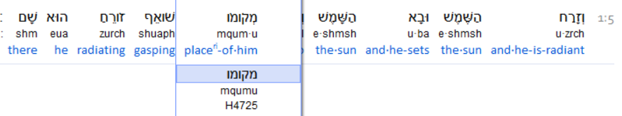
Shall we look at – location – first?
Ecc 1:5
H4725, - place of him.” Note the double Mem letters –
(place of origin for frequency distribution.)
Need a definition refresher? Look at slide 11 again. ☺

Slide 20
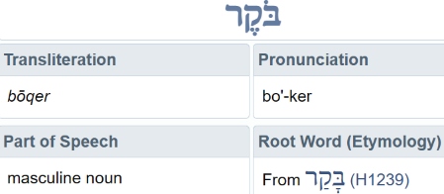
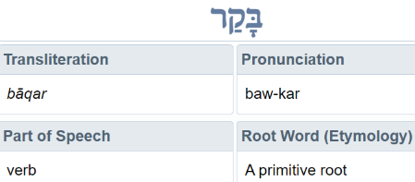
A frequency of the sun?
In terms of TIMING: the sun has two basic frequencies.
#1. There is a 24 hour frequency where it RESTARTS every Dawn.
Dawn (morning) is H1242 Boqer. H1242 is derived from - H1239.
Dawn
H1239
What connects this to a RESTART at DAWN?

Slide 21
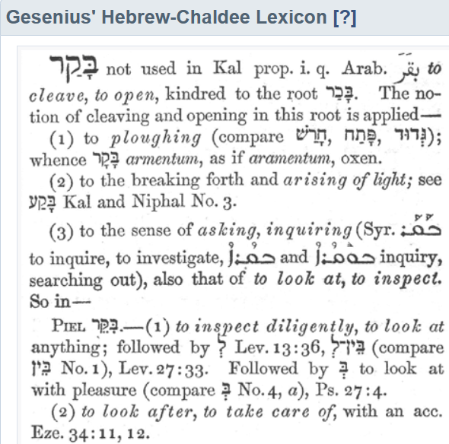
The primitive root –
an ox & plough! ?
H1239
The LIGHT of the sun, has a PRIMIER TASK at DAWN, before sunrise!
OPENS UP, SPLITS, DIVIDES, & SEGRAGATES by REVEALING
the new
24 hour weekly CYCLE.

Slide 22
The 2nd BASE frequency of the sun!
#2. The sun “frequents” the point of Teshuva, being the FINAL CYCLE of Shaneh.
This celestial event terminates the year, it is
the cycle before every Abib (greening) season.
Ya’aqov (James) 1:17 (c) …nor SHADOW
of TURNING.
Trope
G5157
Gen 1:14

Slide 23
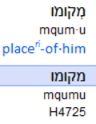
Location format – FUNCTION!
Ecc 1:5
The sun has been assigned a highly specific dwelling PLACE in the heavens named the Tequfah (circuit). The sun does not deviate from this assignment. Intentionally resulting from this ASSIGMENT, COMISSIONED by Yahuah (Gen 1:14 – 16) , is the Teshuva Shadow Sign SPECIFICALLY DESIGNATED before Abib, AS THE LAST CYCLE OF WINTER.
This SHADOW SIGN is THE CATALYST
for counting (Ps 90:12) to Abib 14, (starting the next cycle, at Dawn)! See Ex 12:1-2.
Context:
Sun

Slide 24

Location format - descriptive letters.
Dwelling Place
of the
Sun
Considering the Tequfah (circuit) assignment/commission of the sun
(Psalms 19:4, 6):
We see the descriptive Quf Vav root,
which reveals these definitions -
Stretched out in a straight line,
Stamped out like a plate.
Remember, the frequencies emitted, proceed in like manner as they are created and released!
Let’s explore the implications of
this description!
Ecc 1:5
Ps 19:4

Slide 25
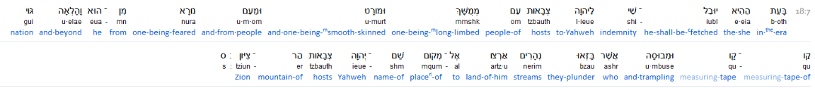


Context: Earth
Quf Vav – A Measuring Tape ??
Isaiah 18:7
וֹ
ק
Isa 18:7
Try applying this to a GLOBE!
Yahuah’s Word, effectively unravels mans traditions!

Slide 26

Descriptive Perspectives.
& the tequfah?
Why “a Plate”?
If you are describing
a very important covenant meal, would your visual description appear like the picture(s)?
Is the red CIRCUIT a “straight line, a measuring tape, stamped out like a plate?”
Does it also provide coverage until the ENDS
of the earth?
Earth?
Where is “the end”?

Slide 27
Descriptive Perspective #2
Perhaps a DOUBLE Tequfah (circuit) would cover –
to the ends of the earth better?
Earth?

Slide 28

Descriptive Perspective - Torah
Or -
Perhaps Yahuah’s single Tequfah (circuit, the BLUE LINE) STRETECHED OUT IN A STRAIGHT LINE, STAMPED OUT LIKE A PLATE, fulfills His command quite effectively?
Might this portray the Quf Vav root definitions better?
Earth
There is MUCH MORE Hebraic definition proof on this. Oh those Hebrew definitions!! ☺

Slide 29
Something to take note of!
As we dig deeper there could be a lot of questions.
Just hang
in there!

Slide 30
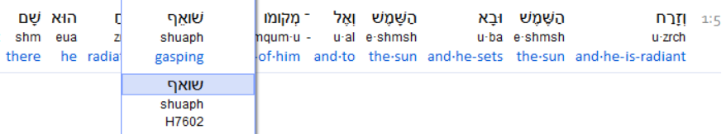
OK, we have looked at some interesting thoughts brought forward by the Quf Vav root word definitions, which, pertain to Yahuah’s formation process of the Tequfah (circuit.)
We have noted the Mem prefix which denotes a
constant FREQUENCY delivery.
This inquiry now transfers to the next word:
Mem
מ
Also, we mark the 2nd Mem, indicating the SOURCE
for this frequency production!
What did Abraham know about this?
Ecc 1:5

Slide 31


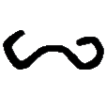

Pey Aleph Vav Shin
Ecc 1:5
Shin, to separate, press in, (with an intensity.)
Vav, a nail or a hook upon which items can
be connected and rest.
Aleph, power & authority, first, the provider,
many times attributed directly
to Yahuah/Yahusha.
Pey, mouth, (message which) speaks.
ש
וֹ
א
ף
Very interesting Lexicon definitions next.

Slide 32
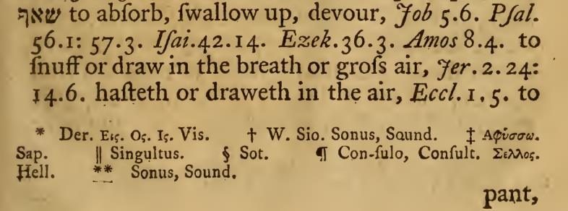
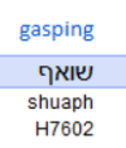
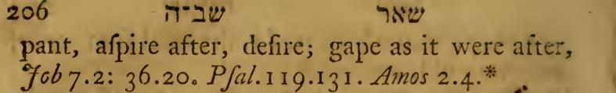

A Hebrew Lexicon W.H. Barker (1776) pg. 205
Ecc 1:5
Note the absence
of the Vav.
Almost appears a bit negative at this point!

Slide 33
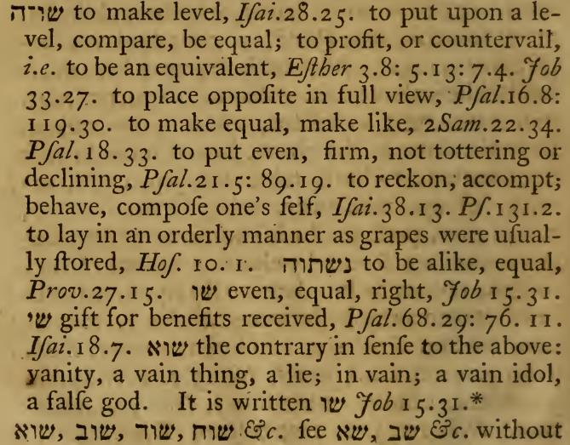
A Hebrew Lexicon W.H. Barker (1776) pg. 226
Ecc 1:5
In the next
2 slides, we will break this quote apart, looking at the Shin Vav root meaning.

Slide 34
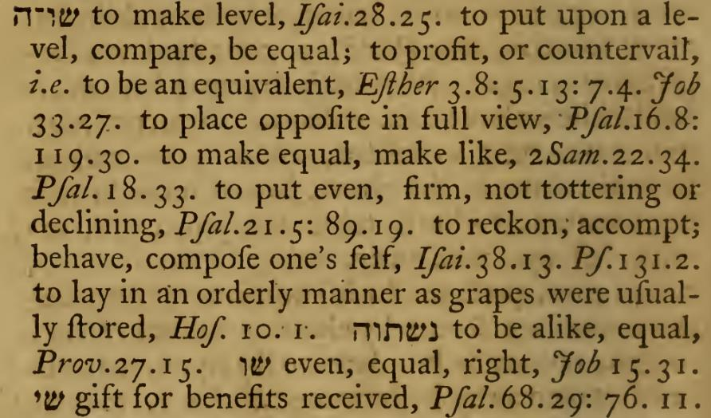
A Hebrew Lexicon W.H. Barker (1776) pg. 226
Ecc 1:5
Looking at the Shin Vav root meanings.
Have you noted the “EQUALITY” theme?
Hold onto this thought.

Slide 35
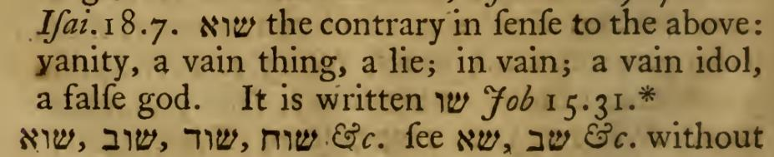
Ecc 1:5
A Hebrew Lexicon W.H. Barker (1776) pg. 226
Continuing on the same quote –
here we see the addition of the
Aleph letter at the end of the word!
א
Remember –
EQUALITY!?
We now need to ask ourselves: is this Tequfah circuit
vanity and vain? Does it contain a false message?
Let’s look at some more definitions!

Slide 36
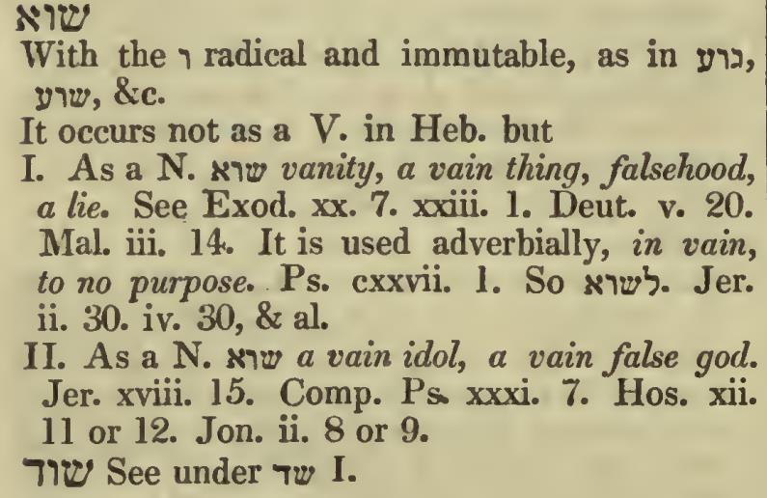
Ecc 1:5
A Hebrew Lexicon J. Parkhurst (1762) pg.
NOTE this spelling carefully!
It seems quite clear the definitions of Shin Vav Aleph are not getting
any better!
Is the Tequfah (circuit), a vanity?

Slide 37


Ecc 1:5
Comparison! Looking at the Ancient Hebrew understanding, the Shin letter is understood as resembling a set of teeth which press in with intensity.
This causes a separation action and a distinguishing focus placed upon the two separated identities.
This (Shin) separation is connected (Vav – hook & or nail) to Aleph (The Almighty Provider), and conveys a MESSAGE which SPEAKS!
(Pey, a mouth).
ש
וֹ
א
ף
Now for THE questions!

Slide 38
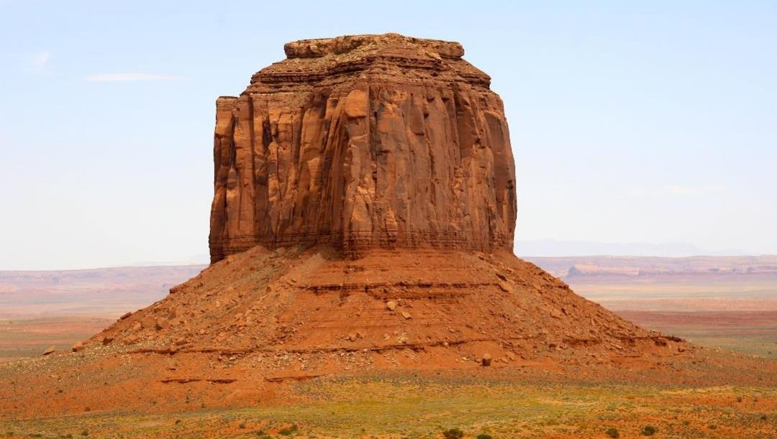

#1. What could possibly be connected, with the sun being IN A HURRY within its Tequfah, to, its intense focus on - GASPING to ACHIEVE LIFE? ??
could connect this “HURRY” scenario, causing
Abraham to be found by Yahuah, SITTING IN THE DOOR of his DWELLING PLACE under the PROTECTIVE COVERING of the OAKS of Mamre?
Ecc 1:5
&
#2. What - on this earth
Pey
ף
Gen 18
Ya’aqov 1:17
shadow

Slide 39
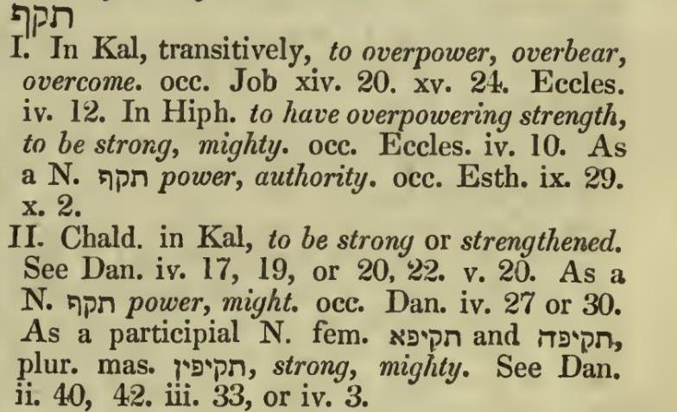
Would it be prudent to look closer at – Tequf; the
letters that form, Tequfah before proceeding further?
Remember –
EQUALITY! ?
Might this be getting closer to a better understanding?

Slide 40
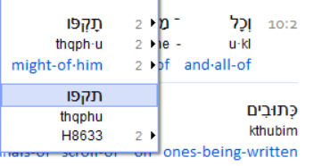
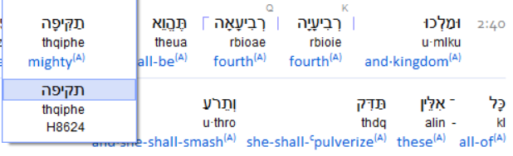
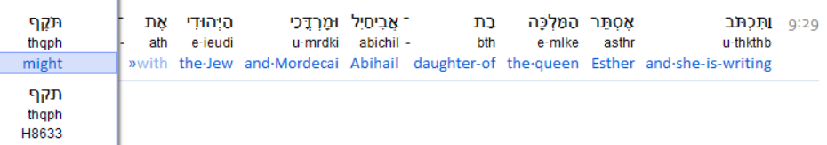
looking closer at – Tquf, root (power/authority)
Esth 10:2 Tqph u
Dan 2:40 Tqipha
Est 9:29 Tqph

Slide 41
We have seen the examples with the context showing the Tav Quf Pey
root word being emphasized as – mighty, and powerful. How can this word shuaph H7602 be linked as descriptive information when delivering –
VAIN, VANITY, FALSE and, an IDOL?
Is there perhaps something more in context we are missing?
Shall we dig deeper into
this astonishing word?
Is there something
we have not seen yet?

Slide 42
Notice the interesting revelations
Job has on H7602 for Job 5:5.
Interlinear
ESV
Peshitta
KJV

Slide 43

Job has more to declare with - H7602
in Job 7 and Job 36.
Brenton’s Eng. Sept.
When a servant is labouring diligently on a tedious work,
can it be that he/she very eagerly seeks shade from the hot sun?
ISV
Be careful what your heart has a quest for. It might well serve you harm!
H7602 Shuaph supplies us with the understanding of an existence
in an intense desire from within.

Slide 44

The sun rises and the sun goes down and hastens to the place where it rose that from thence it may rise again. Ecc 1:5
Ancient Eastern Texts of the Aramaic Peshitta
What is it about this description –
an intense desire, need, and /or, necessity, -
of the sun to accomplish a completed - Tequfah (circuit)?
What is it that pertains to this pinnacle point of termination,
that enables a new beginning?
WHO DECLARED IT SO?
And – WHEN?

Slide 45
This month shall be for you the beginning of months.
It shall be the first for you of the months of the year.
Ex 12:2
Interlinear Scripture Analyzer
Was Yahuah introducing a new concept to Mosheh that he knew nothing about? For what reason had Yahuah preserved Mosheh, educated and trained him, as if for a future Pharaoh position?
Mosheh became an expert in knowledge and execution of, Yahuah’s Shaneh (year) schedule based upon the shadow of the Teshuva. The Teshuva describes the action of two specific cycles of the year, upon which the TURNING (Teshuva), of the celestial bodies REVEALS
a degree of LIGHT, within the Straight Line Shadow.
Acts 7:22
Jas 1:17 Every good gift and every perfect gift is from above, coming down from the
Father of LIGHTS, with whom there is no change, nor shadow of turning.

Slide 46




This month shall be for you the beginning of months.
It shall be the first for you of the months of the year.
Ex 12:2
Interlinear Scripture Analyzer
Yahuah re-certified the authority of the Teshuva Shadow
(a straight line) which determines the END of the previous year.
The Teshuva letters are Tav, Shin, Vav, Heh seen below spelled in correct Hebrew order from right to left –
Teshuva is a verb, and when applied to Shaneh (year) it denotes a
point of turning. Two specific points: ONE, of SUPERIOR authority!
There are TWO of these peculiar events within one Shaneh (year).
ה
וֹ
ש
ת
Paleo
Flame
Shadow at Equinox
Yahuah chose - ONE TESHUVA, as the CATAYLIST EVENT!

Slide 47
Ex 12:2
Interlinear Scripture Analyzer
This month shall be for you the BEGINNING of months.
It shall be THE FIRST for you of the months of the year.
Why is it termed as a - “CATAYLIST EVENT?”
By many Scriptural examples, the STRAIGHT SHADOW LINE, which occurs on the Teshuva TURNING POINT, immediately prior to – (hours before the month of Abib), the shadow finalizes that Shaneh. The Shadow announces (enables), the New Year’s 1st cycle to commence with the ensuing - LIGHT OF DAWN!

Slide 48

Ecc 1:5 Hurries
Shemesh is the Sun!
The “Shemesh Scurry!” ☺
Remember, in all this, that the Shin letter shows a DIVISION OF SOMETHING!
So, the questions intensify:
What reason causes the sun to be recorded under Hebrew definition as - in an INTENSE HURRY (Ecc 1:5) to return back to
the place where it arose? Where is - “THAT PLACE”?
Why is it recorded the sun is under such a purposeful commission to the extremity of GASPING, AS IF FOR AIR, or - (LIFE)?

Slide 49

Hurries
The “Shemesh Scurry!” ☺
The “lesser” 24 hour SCURRY!
Yahuah’s mercy reneweth every DAWN !
365+, a daily 24 hour cycle, 7 times every week!!
52 Weeks every SHANEH (year)!
Lam 3:22-23 It is of [Yahuah’s] mercies that we are not consumed, because his compassions fail not.
They are new every morning: great is thy faithfulness.

Slide 50
Hurries
Why is it recorded the sun is under such an EMPHASIZED purposed commission to the extremity of GASPING,
as if for - LIFE - itself?
And if it were for LIFE, what life would it support?
What IS DETAILED HEBRAICALLY about the “place where it arose”
that its commission could be considered important
- EQUAL TO OXYGEN?

Slide 51
Hurries
EQUAL TO OXYGEN???
How can this be? Where have we seen even the
slightest indication of - oxygen?
Let’s revisit a slide shall we?
It is a Hebraic description of the Tequfah, the circuit of the sun! Yahuah has declared that this circuit has
a starting and ending point! WHY?

Slide 52
A Hebrew Lexicon W.H. Barker (1776) pg. 205
Ecc 1:5
This is a 2nd viewing!
What elemental NECESSITY causes a body to “draweth in air”?
To aspire after …? Could it be –
OXYGEN,
- that which supports – LIFE?

Slide 53
The sun is - In a HurrY - for what? ???
Normally we hear of Teshuva in context of relationship with Yahusha Ha Mashiach. Sinners may stop their futile life in this world, TURN 180 degrees,
and begin a purposeful life with Yahusha.
They have intentionally changed the mode of operation
in their lives and have chosen a PURPOSEFUL option.
The flux in their life has STOPPED, and another -
SEPARATE - identity has BEGUN! Hallelu-Yah!
However, we are looking for the context of specific TIME!
Let’s get Scriptural -

Slide 54
Teshuva’s intentional PURPOSE! #1
2 Sam 11:1 And it came to be at the turn of the year [teshuva], at the time sovereigns go out to battle, that Dawiḏ sent Yo’aḇ and his servants with him, and all Yisra’ĕl, and they destroyed the children of Ammon and besieged Rabbah. But Dawiḏ remained at Yerushalayim.
1 Ki 20:22 And the prophet came to the sovereign of Yisra’ĕl and said to him, “Go, strengthen yourself. And know and see what you should do, for at the turn of the year [teshuva] the sovereign
of Aram is coming up against you.”
1 Ki 20:26 And it came to be, at the turn of the year
[teshuva], that Ben-Haḏaḏ mustered the Arameans
and went up to Aphĕq to fight against Yisra’ĕl.

Slide 55
Teshuva’s intentional purpose! #2
1 Ch 20:1 And it came to be at the turn of the year [teshuva], at the time sovereigns go out to battle, that Yo’aḇ led out the power of the army and destroyed the land of the children of Ammon, and came and besieged Rabbah. But Dawiḏ remained at Yerushalayim. And Yo’aḇ smote Rabbah and overthrew it.
2 Ch 36:10 And at the turn of the year [teshuva] Sovereign Neḇuḵaḏnetstsar sent and brought him to Baḇel, with the valuable utensils from the House of יהוה, and made Tsiḏqiyahu, Yehoyaqim’s brother, sovereign over Yehuḏah
and Yerushalayim.

Slide 56
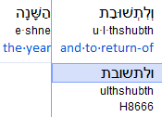
Teshuva up close!
Please notice that in each of these verses the word Shaneh is present. This is a direct connection to Gen 1:14, the 4th cycle of creation.
Shaneh indicates through Hebrew definition that this type of year must be of a DUPLICATION. A “seed within a seed according to its own kind” identity. This means the year identity must be a perfect match from the year previous to it.
There must be a “governing cut off point” which has the authority to RE-produce the 360 cycle Worship Year in sequentially exact segments.
This sequence began at Genesis 1:1, the very first cycle of creation, and continues - today!
2 Chron 36:10
Interlinear Scripture Analyzer
Interestingly, any lunar type year, any Dead Sea Scroll affiliate or any other calendar which incorporates intercalation of any kind, cannot fulfill Shaneh starting from Genesis 1:1!

Slide 57
Is Teshuva the - CUT OFF CATAYLIST?
The Teshuva (turning point) of the celestial identities, provides a STRAIGHT LINE SHADOW (James 1:17), that determines the final cycle (day) of a Shaneh (year). The very next Dawn, is the first cycle of the new year. From this New Year Cycle, being #1, the count to Abib 14, Passover, begins. The MO-EDIM COUNT starts with strict accordance to the event occurrence of the Teshuva Shadow. This specific Teshuva Shadow is only produced by the commission of the sun, being commanded to return to its designated starting point within the Mazzaroth. This commission is accomplished within Yahuah’s peripheries of the Tequfah (circuit) as
outlined in Ecc 1:5.
2 Chron 36:10
Interlinear Scripture Analyzer
Questions:
What is the base IMPORTANCE of the
Mo-edim? - LIFE?
Why is the sun described as “gasping for air” (LIFE) to get back to the finish point of its circuit?

Slide 58
Is - Teshuva that which provides LIFE?
The Teshuva (turning point) of the celestial identities, provides a STRAIGHT LINE SHADOW (James 1:17). Is it possible that Yahuah allotted this SHADOW phenomena as a SIGN (Gen 1:14) emanating from
the TWO GREAT LIGHTS recorded on
cycle #4 of the Creation week?
What are the entities that formulate this SIGN? 1> Sun 2> Light
3> Mazzaroth & 4> Earth.
Without even one of these identities, the cyclical
Way (Mo-edim - LIFE), would not exist.
The Mazzaroth identifies the TIMING LOCATION.
The sun CONDUCTS the correct action across the heavens.
The sun Light dictates the appropriate SIGN/SIGNAL.
The earth receives this Covenant, marked as a Shadow degree of Light!
Gen 1:14

Slide 59
“You have removed THE KEY to understanding …” Luke 11:52
When a purposeful DISREGARD for even one of these identities occurs, the cyclical Way (Mo-edim - LIFE), will cease to be understood on earth.
The Mazzaroth identifies and establishes the
TIMING LOCATION Prophetic markers, past, present, AND FUTURE.
The sun CONDUCTS the correct DEFINING action DELINEATING a
Straight Line Path across the heavens, 2 times a year.
Gen 1:14
The sun Light dictates the appropriate SIGN/SIGNAL by forming
a Shadow via a staff in the ground. This staff enables The Shadow which is to be MARKED & DETERMINED by man.
Recall -Serpent staffs of
Egypt! ?
The earth receives this Covenant, in marked form as a Shadow,
the degree of Light commissioned by Yah, in Gen 1:14-18!

Slide 60
What is your part?
Are YOU WILLIING to MARK OUT
the Shadow?
The accumulative ingredient! You!
Moving forward.

Slide 61
Note:
The MOON has no part of this commissioned
SPIRITUAL FORMULATION
which articulates the Worship Mo-edim
within Yahuah’s Shaneh (DUPLICATING year).
Nor is there any mention of the moon in Creation week!
Appointment Accuracy - Timing - is PARAMOUNT!
The moon has its own ordinances of which
it provides life for agricultural purposes.

Slide 62
The sun in Ecc 1:5 is recorded in English as hurrying back to the place where it arose.
The Hebrew definitions describe an intensity as deep as GASPING FOR AIR!
When one swims under water for a time, and returns to the surface, there is one necessity.
Your lungs are CRYING FOR AIR! The top priority at that moment is to draw in air,
namely – OXYGEN, for survival, FOR LIFE!
Ps 90:12
What is it that the sun’s course of action - Tequfah - is intensely
preserving? Is it encompassed within the Covenant?
Could it be THE COUNT which the sun is bent on preserving?
The Teshuva Shadow Sign, as mentioned, signals the impending TIME
to begin THE COUNT to Abib 14 (Passover) at the next Light of Dawn.
Passover first involved death. Passover was timed in a Type format by the Shadow of Teshuva. Passover was FULFILLED IN THE ANTITYPE ACCORDING TO THE SHADOW OF TESHUVA! Yahusha exclaimed – It has been accomplished! The Teshuva also timed that Wave Sheaf Presentation of First-Fruit, by - Yahusha Ha Mashiach’s after His resurrection!!
Without that Shadow of Teshuva … ?!? Let’s view – The Way!

Slide 63
Within WHAT identity is the sun - in a HURRY?
KJV
Mazzaroth Job 38: 31 - 33
Psalms 19:4 Their line has gone out through all the earth. And their
WORDS to the end of the world. In them He put a tent for the sun.
Is the
sun
persistently hurrying
for a “tequfah”?
No! The sun is already functioning within its Tequfah (circuit {Gen 1:5, ereb})!
It is seeking something within that circuit! There exists a special identity, that the sun fully & intentionally determines to achieve, within that very Tequfah (circuit)! WHAT IS IT?

Slide 64
Speaks without a VOICE! Ps 19:3!
Psalms 19:4 Their line … Who’s line?
The message which SPEAKS, is encased within the Mazzaroth (constellations) and covers the whole earth! “Their Line” is Yahuah’s designated
Pathway, or Track, upon which they
FREQUENT to guide humans who
accept Yahusha! Gen 1:14 – 18, Psalms 19.
Ps 19: 3
context
is
The Mazzaroth!
Ps 19:4 declares the sun has been designated a DWELLING PLACE – AHEL (tent). It is within the Mazzaroth’s domain, to which the sun has been commanded to inhabit! That highly specified habitation is deemed by Yahuah as the Tequfah (circuit)!

Slide 65
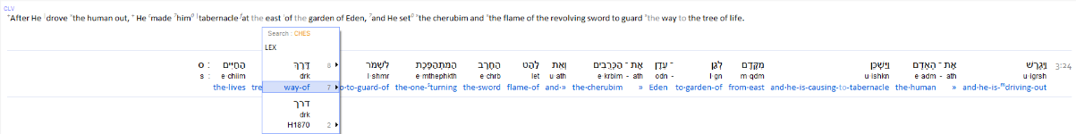
“Teshuva Shadow STOPS the count!
The Tequfah count restarts the next Dawn!
The Teshuva Shadow Sign, as mentioned, signals the
impending TIME to begin THE COUNT to Abib 14 (Passover)
at the next Light of Dawn.
Passover first involved death.
With death, came LIFE – Yahusha’s resurrection!!
There is much more to this life concept. Let’s consider – The Way!
Ps 90:12
Gen 3:24 And He drove the human out, He made him tabernacle at the east of the garden
of Eden, and He set the cherubim and the flaming revolving sword to
GUARD THE WAY to the tree of life.
Gen 3:24
Shemar – Guard!

Slide 66
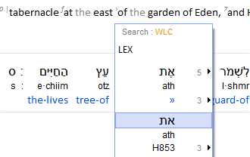
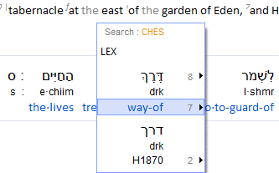
In Ecc 1:5 the sun is recorded in English as hurrying back to the place where it arose.
The Hebrew definitions describe an intensity as deep as GASPING FOR AIR!
As mentioned in swimming, upon your return to the surface, there is one necessity.
Your lungs are CRYING FOR AIR! The top priority at the time is to draw in air, namely – OXYGEN, for survival, FOR LIFE! Keep this thought!
Interlinear Scripture Analyzer
Note the H853 Aleph Tav is seen before H1870 derek. They have a direct connection.
The Aleph Tav, the Beginning and the Ending, being linked directly to the Tree of Lives (plural), was/is being guarded by Yahuah.
The “Qodesh Pathway” to the Tree of Life is
termed in Hebrew as H1870 - Derek – The Way.
ת
א
Gen 3:24
Please remember this term – TREE OF LIVES –
as we will return to this shortly.

Slide 67



What is the “Way” (Derek)?
Looking at the Paleo letters we see –
Remember Yahusha said – “I am the door: by me if any man enter in,
he shall be saved, and shall go in and out, and find pasture.” John 10:9
Dalet is a door. A Door, a portal, to where? Eternal Life?
Resh is the head. The top identity in charge of the Universe. Yahusha?
Kaph is the palm of the hand. The palm maintains a grip on circumstance.
What is this “The Way’ system that has the ability to usher humans into - the Kingdom of Yahuah?
Might we see the basic “entry application” format in Leviticus 23?
Kaph
(palm/grip)
Resh
(head)
Dalet
(door)

Slide 68
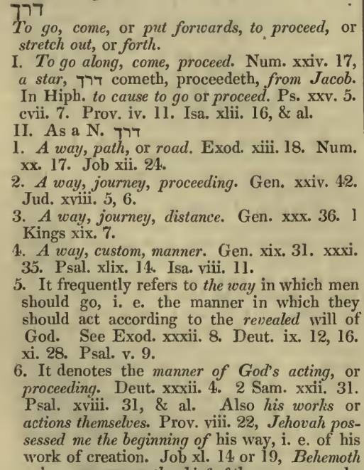
A Hebrew Lexicon by J Parkhurst 1762 pg. 176
What is - “Way” (Derek)?
Context - Mo-edim
Exo 32:8 “They have turned aside quickly out of THE WAY which I commanded them. They have made themselves a moulded calf, and have bowed themselves to it and slaughtered to it, and said, ‘This is your mighty one, O Yisra’ĕl, who brought you out of the land of Mitsrayim!’ ”
mo-ed
Deu 9:12 “Then יהוה said to me, ‘Arise, go down quickly from here, for your people whom you brought out of Mitsrayim have acted corruptly. They have quickly turned aside from THE WAY which I commanded them, they have made themselves a
moulded image.’
Let’s read!
FEAST
Counterfeit system for worship.

Slide 69
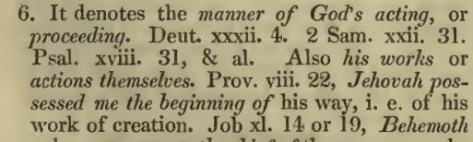
A Hebrew Lexicon by J Parkhurst 1762 pg. 176
What is - “Way” (Derek)?
Continued
Deu 32:4 “The Rock! His work is perfect,
For all His WAYS are right-ruling,
An Ěl of truth and without unrighteousness, Righteous and straight is He.”
Deu 11:28 “And the curse, if you do not obey the commands of יהוה your Elohim,
but turn aside from THE WAY which I command you today,
to go after other mighty ones which you have not known.”
2 Sam 22:31 “The Ěl – His WAY is perfect; The Word of יהוה is proven;
He is a shield to all who take refuge in Him.”
Pro 8:22 “יהוה possessed me, The beginning of His WAY,
As the first of His works of old.”

Slide 70
SPIRITUAL MICROSCOPE INTO THE PHYSICAL
AGAIN:
Deu 11:28 “And the curse, if you do not obey the commands of יהוה your Elohim,
but turn aside from THE WAY which I command you today,
to go after other mighty ones which you have not known.”
The Eternal PI (3.14. of Gen 1:1) DUPLICATING - Seed within a Seed verses 11 & 12!
If you reject Yahuah’s Teshuva Shadow method of determining time as commissioned in Genesis 1; and persistently gravitate to the lunar system (as distinctly recorded in Isaiah 1), which syncretizes paganism
with/ into - Yahuah’s Qodesh format for LIFE.
If you choose to determine time (feasts) by Jericho’s DEFUNCT lunar system, even though the LUNAR WORSHIP FOUNDATION (WALLS), were DRIVEN INTO THE GROUND (on the 13th trump of a SILVER SHOFAR).

Slide 71
SPIRITUAL MICROSCOPE INTO THE PHYSICAL #2
AGAIN:
Deu 11:28 “And the curse, if you do not obey the commands of יהוה your Elohim,
but turn aside from THE WAY which I command you today,
to go after other mighty ones which you have not known.”
TODAY
If you REJECT the repeated efforts of Yahuah to extract Yisra’el (TODAY) from worshipping OTHER GODS (Ba’al, Sun god and Ashtoreth, Moon god).
If you reject Revelation 12:1 Bethula the Bride of Yahusha, standing above (NOT ON!) the moon, in a symbol of absolute victory over the lunar system
of determining COUNTERFEIT feasts of the Yahudim. (See John 7:2, 6, 7 & 19)
If you reject Solomon building the LAVER (sea) founded upon TWELVE BAQAR (oxen hooves) COMPLIMENTING, LEADING INTO - Bethula’s TWELVE stars (months) on her “Shaneh crown”, INDICATING A SHANEH (year), WHICH HAS NEVER CHANGED (Mal 3:6) since its inception at Gen 1:1 – 5!

Slide 72
SPIRITUAL MICROSCOPE INTO THE PHYSICAL #3
AGAIN:
Deu 11:28 “And the curse, if you do not obey the commands of יהוה your Elohim,
but turn aside from THE WAY which I command you today,
to go after other mighty ones which you have not known.”
Out of Covenant
If you reject Solomon’s 12 Baqar (LAVER, OXEN HOOF) FOUNDATION which exudes AUTHORITY through The Ox, of which –
Boqer (DAWN) is a derivative of the root word Baqar!
The TWELVE (NOT THIRTEEN) LAVER FEET indicate a BRINGING FORTH
OF LIGHT (dawning) twelve times per Shaneh (year). The Laver represents a gathering point (the SEA of people) for which the MelkiTzedek PRIESTS OF YAHUSHA are to cleanse themselves of contamination! Cleanse ourselves from the abomination of the lunar 13th month system (Jericho) and strive to attain status only achieved through the Ruach Ha Qodesh, in order to sit at the feet of Yahusha Ha Mashiach as one of the Bride, ON THAT GREAT DAY!
Isa 1:16

Slide 73
The Laver’s – TWELVE Oxen Feet!
Aleph Tav
1 Kings 7:44 And one sea, and twelve oxen ^{H1241} under the sea.
In the Ancient Hebrew Aleph Tav, Yahuah is represented as The Aleph, the Ox.
Eyelashes
of Dawn
Job 3:9
The Scriptures
The Aleph, the SOURCE of LIGHT ,
Spiritual 1st, Physical 2nd, equals - LIFE.
This word, Beit Quf Resh (Boqer) is ALSO the word for DAWN! Light! The Baqar feet of the Laver, WHEN USED TO CLEANSE PAGAN CONTAMINATION – LUNAR (JERICHO) deceit from one’s life, LIGHT OF THE SON Yahusha Ha Mashiach is DAWNED (brought forth bursting out as the eyelashes of DAWN), into the person who has chosen to become a new MelkiTzedek Priest for Yahuah!

Slide 74
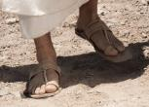
The Laver’s – TWELVE - Oxen (Sandal) FOUNDATION!
The Eye Lashes of Dawn!!!
Yahusha’s Testament, not just His spoken voice, BUT HIS SANDALS SPEAK!
Eyelashes
of Dawn
Job 3:9
The Scriptures
A DOUBLE PORTION by His SANDALS SPEAKING!!
Gen 32:24 And Yaʽaqoḇ was left alone. And a Man wrestled with him
until the breaking of day.
Gen 32:26 (a) And He said, “Let Me go, for the day breaks.”

Slide 75
OK! Back from a bit of a Bunny Trail! ☺
Let’s scamper back to –
What is THE WAY, that the BAQAR (oxen laver feet) beckon us to RESTORE?

Slide 76
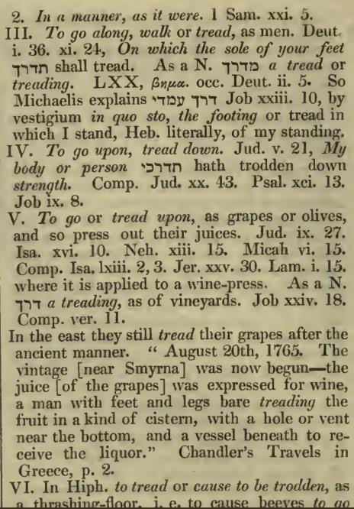
A Hebrew Lexicon by J Parkhurst 1762 pg. 175
What is - “Way” (Derek)?
Assessment
As we view the different contexts in how this word “derek” is used in the Scriptures, it becomes very apparent that “derek” can be used to directly reference the MelkiTzedek Covenant which contains the
cyclical Mo-edim of Yahuah.
Cyclical, in that they return to the starting point
(Ecc 1:5) each Shaneh (year, Gen 1:14) and start over once again to repeat (seed within a seed – Gen 1:11, 12), the Plan of Salvation encapsulated within the Festal Pattern methodology of Yah!
What about the GRAPES? Should we - “DEREK” - TREAD & CRUSH OUT the JUICE OF LIFE FROM THE TORAH? Isn’t crushing the grapes a form of dissecting, to reveal and harvest that which is on the INSIDE?
What substance is filling YOUR CISTERN?

Slide 77
As per specific context, “Derek” can be observed as directly referencing the cyclical Festal Schedule which revolves/returns - every year.
How does this relate to the sun being in a HURRY to return back
to its starting point? [Ecc 1:5?]
Let’s quickly step out of the line and examine Proverbs 8:22 in another light.

Slide 78
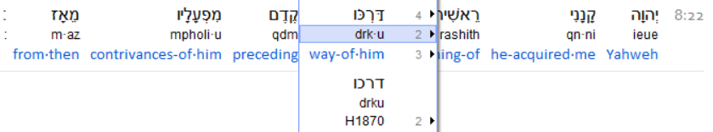

Prov 8:22 ~ could it be - the Way existed before the creation of this earth!
Lev 23:2 Speake vnto the children of Israel, and say vnto the: The feastes of [Yahuah] which ye shall call holy conuocations, euen these are My feastes.
Not just Feasts, but A LIFESTYLE!
Bishops 1568
Pro 8:22 “יהוה possessed me, The beginning of His WAY, As the first of His
works of old.”
If the system of Festal Mo-edim and the MelkiTzedek Order existed prior to the creation of this earth, is it possible this system by design was incorporated as THE SEED (Gen 1:11,12) “planted” onto this earth? The intentional “DNA” of Salvation?

Slide 79
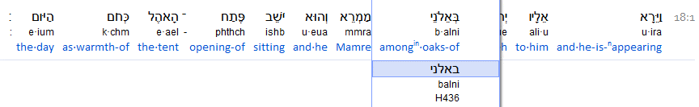
How does – H1870 Derek, provide the Pathway to the Tree of Lives?
Gen 3:24
This is a picture of what once was a massive tree.
A pillar of strength that could be observed over a GREAT distance.
Abraham had made himself COMFORTABLE (sitting) in the protection of
the oak trees - in
the HEAT of the afternoon.
How far does one move when SEATED?
Gen 18:1

Slide 80



Part 2 will be examining these Hebrew words.
Did Abraham pay attention to the “SCURRY” of the Shemesh (sun)?
We shall see! ☺
Was Abraham seated in The Way?
Or was he simply
in the
door of his tent?
Gen 18:1
The End

Slide 81
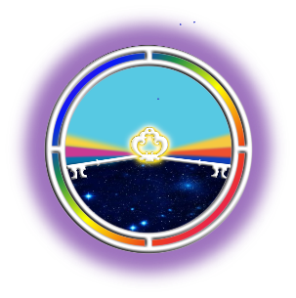

If you have
Questions &/or
Comments
about this
teaching,
please
contact
us:
Covenant Calendar Classroom
questions@studythecalendar.com
Thank you!

